Slide 1
What will we be covering today?
Explain the patterns of settlement
Describe and explain the factors which may influence the sites, growth and functions of settlements
Give reasons for the hierarchy of settlements and service
Dispersed, linear, and nucleated settlement patterns
Influence of physical factors (including relief, soil, water supply) and other factors (including accessibility, resources)
High-, middle- and low-order settlements and
services. Sphere of influence and threshold
population

Slide 2

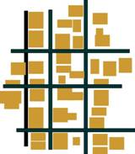
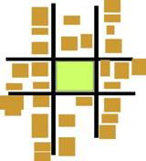
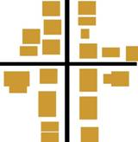
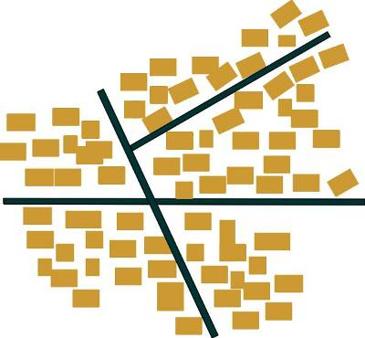

How is the shape of a settlement classified?
Linear
Planned
Ring
Cross
Dispersed
Nucleated

Slide 3
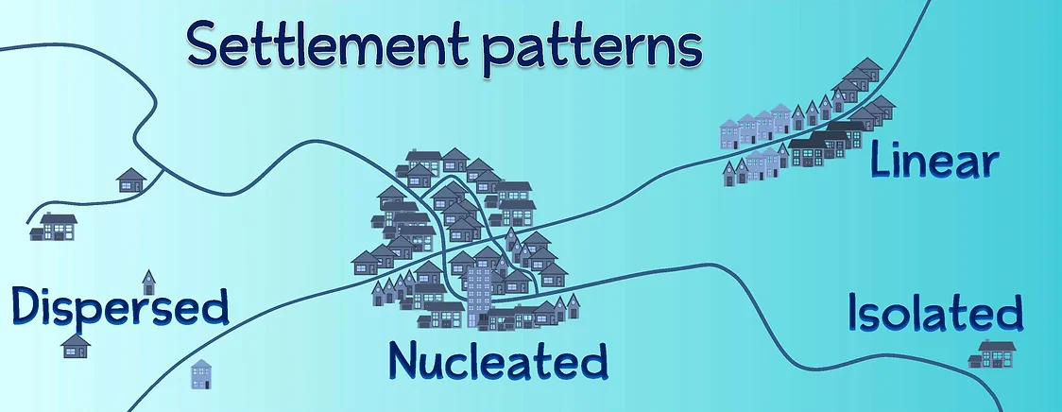

Slide 4
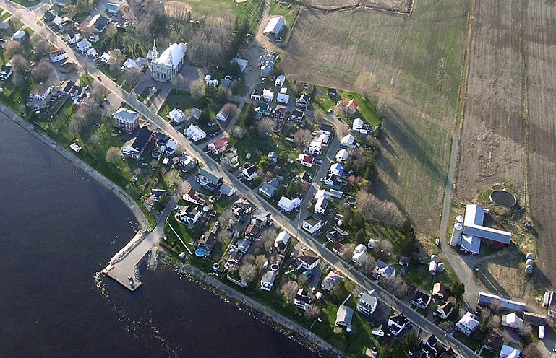
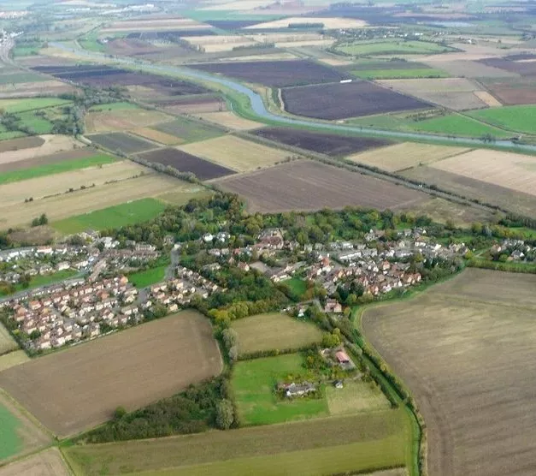
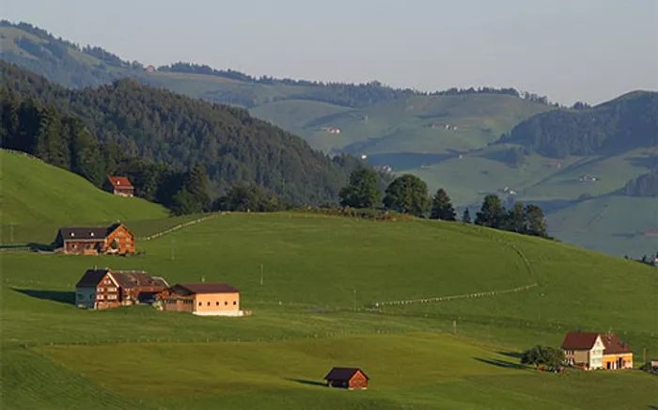
where the houses are grouped closely together, often around a central feature like a church, pub or village green. New settlements that are planned often have this type of settlement.
Dispersed settlements
Champlain, Quebec, Canada
ones where the houses are spread out over a wide area. They are often the homes of farmers and can be found in rural areas.
Linear settlements
Little Thetford in England
settlements where the buildings are constructed in lines, often next to a geographical feature like a lake shore, a river or following a road.
Where linear settlements follow a road, the road often predates the settlement.
nuclear settlements
Brülisau in Switzerland

Slide 5
where the houses are grouped closely together, often around a central feature like a church, pub or village green. New settlements that are planned often have this type of settlement.
Little Thetford in England
nuclear settlements
settlements where the buildings are constructed in lines, often next to a geographical feature like a lake shore, a river or following a road.
Where linear settlements follow a road, the road often predates the settlement.
Linear settlements
Champlain, Quebec, Canada
ones where the houses are spread out over a wide area. They are often the homes of farmers and can be found in rural areas.
Brülisau in Switzerland
Dispersed settlements

Slide 6
Where do they occur?
Dispersed settlements usually occur in:
remote or mountainous regions
areas where the land is predominantly used for agriculture
areas with limited job opportunities
locations with few, if any, job opportunities
A linear settlement pattern occurs in a line or arc shape. They typically follow a road, valley or water body. This allows the settlement to utilise transport routes. They can also occur along valley floors where the sides are very steep.
A nucleated settlement occurs in a circular shape with buildings mainly concentrated around a common centre such as a road junction, park or service area. Most large cities are nucleated indicating they are well planned. Nucleation occurs due to:
flat relief which is easy to build on
the site has a bridging point
the site is a good defensive position
a good water supply
no restrictions to development in any direction
good job opportunities
effective public services
good transport links

Slide 7
Site Factors
Imagine it’s 1000s of years ago. You’re roaming the countryside trying to decide where to live.
What do you look for?
Notes:
Starter slide

Slide 8
Site factors
Settlements were often built by rivers, because the river could provide various advantages.
Advantages of a particular site are called site factors.
What advantages can being next to a river bring?

Slide 9
Site Factor | Definition
1) Wet point | a) Where routes met- roads, rivers or valleys- settlements were developed because of the easy access.
2)Dry point | b) The direction that an area faces can affect whether settlements develop there- those which are south facing get lots of sunlight and are best for farming. Some settlements also develop at the bottom of hills or mountains where they are sheltered from poor weather conditions.
3) Nodal point | c) Settlements were located here because there was a good supply of water, often on the flat floodplains beside rivers; eg towns and villages in the Welsh Valleys
4) Bridging point | d) In medieval times, important settlements were built on top of large hills or within bends of a river to protect them from enemies, eg Edinburgh Castle.
5) Aspect and shelter | e) These settlements were located on slightly higher ground than the surrounding area because it was less likely to flood, eg Ely, Norfolk.
6) Defence | f) Rivers could cause a barrier to travel, so many settlements developed where rivers were narrow, shallow or had islands so that it was easy to cross them.

Slide 10
1) Wet point | c) Settlements were located here because there was a good supply of water, often on the flat floodplains beside rivers; eg towns and villages in the Welsh Valleys
2) Dry point | e) These settlements were located on slightly higher ground than the surrounding area because it was less likely to flood, eg Ely, Norfolk.
3) Nodal point | a) Where routes met- roads, rivers or valleys- settlements were developed because of the easy access.
4) Bridging point | f) Rivers could cause a barrier to travel, so many settlements developed where rivers were narrow, shallow or had islands so that it was easy to cross them. .
5) Aspect and shelter | b) The direction that an area faces can affect whether settlements develop there- those which are south facing get lots of sunlight and are best for farming. Some settlements also develop at the bottom of hills or mountains where they are sheltered from poor weather conditions.
6) Defence | d) In medieval times, important settlements were built on top of large hills or within bends of a river to protect them from enemies, eg Edinburgh Castle

Slide 11
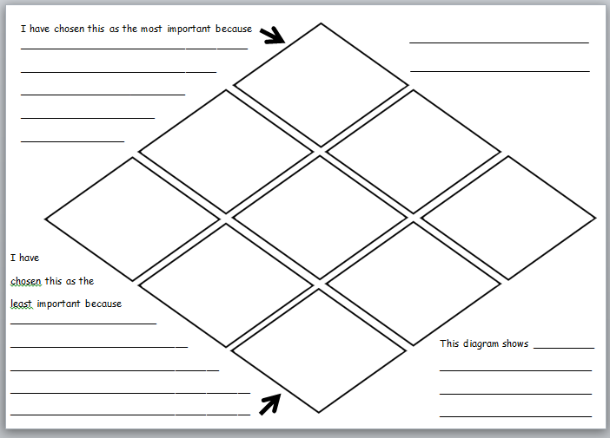
Diamond Ranking Grid: The importance of site factors.

Slide 12
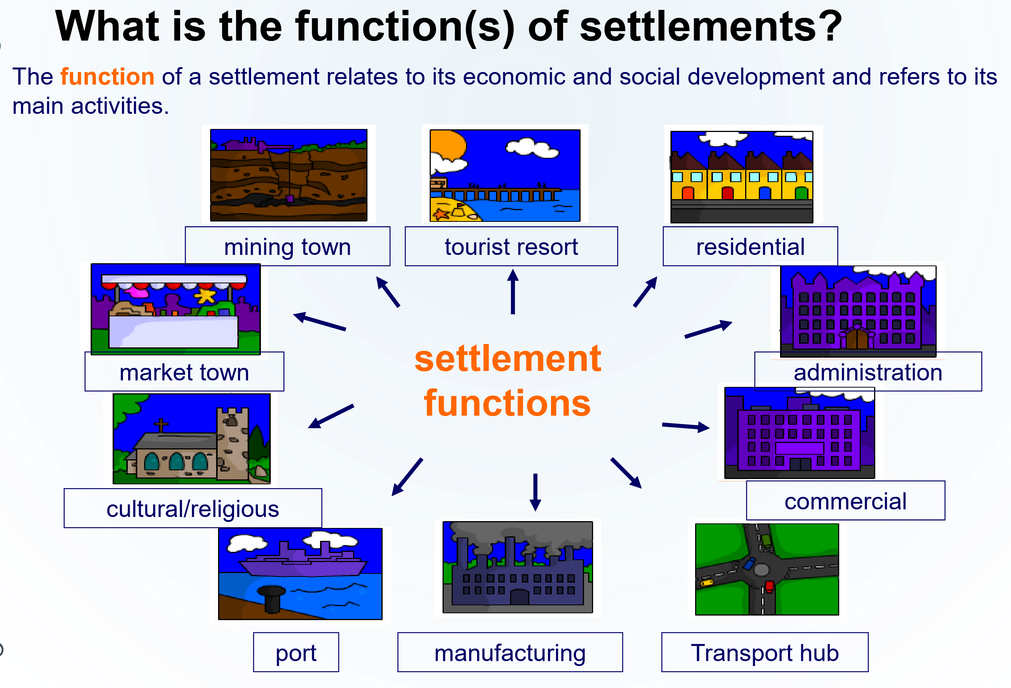

Slide 13
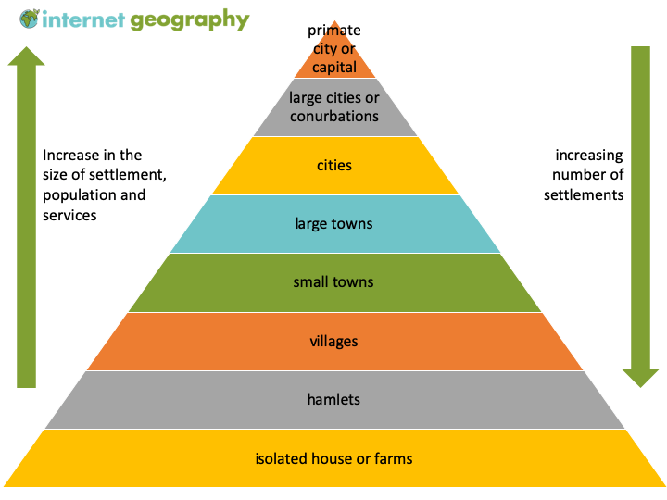
Settlement Hierarchy
What services/amenities will you find at these different scale settlements?

Slide 14
Settlements in the hierarchy are interdependent as people will use a variety of services found in different settlements. The area served by a particular settlement is known as its……………………………………….. The size of this will be dependent not only on the type and number of services offered by a town but also the size of the town and the ease of access related to the available transport networks serving the area. …………….. usually provide few services, and those that exist are mainly low order services or sell low order goods. ………………………………….are those that are low in value / cost and are used / required daily, for example …………………………………... Larger towns and services will have a greater range of services, including both low order and high order goods and services. ………………………………………are more expensive in nature and not required so frequently. They are often comparison goods, such as ………………………………………….. and people are usually prepared to travel further in order to get them. The distance that people are prepared to travel to use a service or obtain a good is known as its ………... Services such as hypermarkets and goods such as furniture have a much greater range than for example a newsagents and milk.
In order to be profitable, a shop or service will require a minimum number of potential customers, this is known as its ………………………... Shops/services providing low order goods or services usually need a much ………. threshold population (as the goods / services are required / used daily), whilst high order shops / services will require a much ……… number of potential customers and thus have a higher threshold population. Marks and Spencers for example may require a threshold population of 70,000 before the store can be profitable.
threshold population
Low order goods / services
range
sphere of influence
Villages
High order goods and services
furniture, electronic goods etc
milk / newsagents
greater
lower

Slide 15
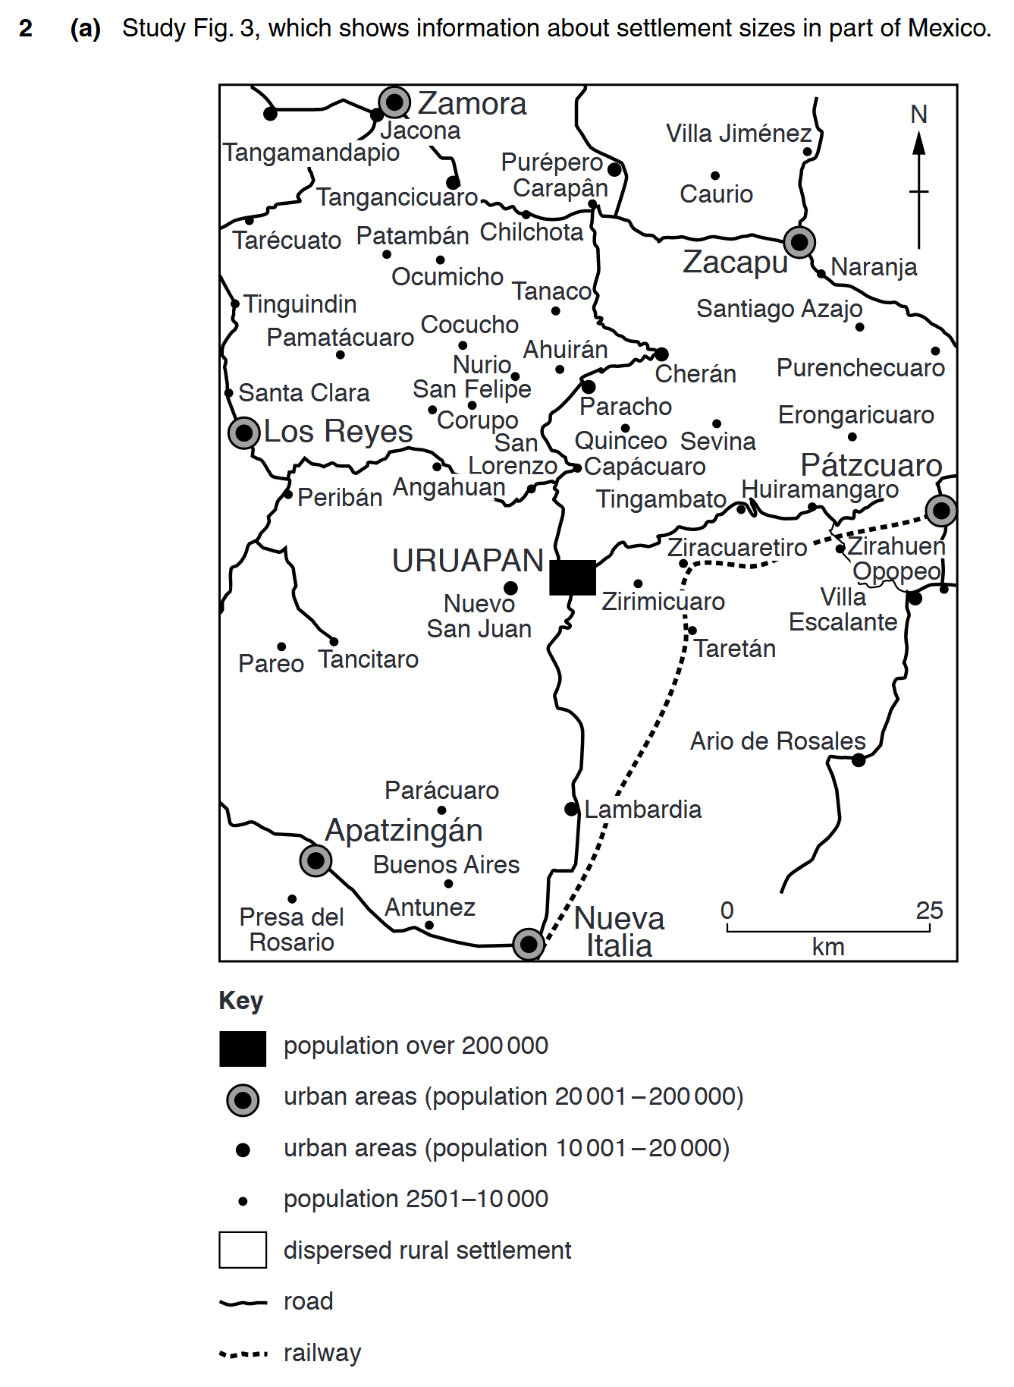
(ii) What is meant by:
A an area of dispersed rural settlement;
................................................................................................................................................................................................................................................................................................
B an urban settlement?
............................................................................................................................................................................................................................................................................................[2]

Slide 16
How did you do?
(ii) A. An area of countryside with scattered buildings/houses/separated by distance/large
area where houses/services are separated/outside city;
NB: need both dispersed idea and rural location for mark.
B. A built up area/town/city/area with high population/high density buildings/lots of
people live there/industrialised area; (2 × 1 mark) [2]

Slide 17
(iii) Suggest three possible reasons for the growth of large settlements such as Uruapan.
1 ..................................................................................................................................................................................................................................................................................
2 .......................................................................................................................................................................................................................................................................................
3 .................................................................................................................................................................................................................................................................................[3]

Slide 18
How did you do?
Ideas such as:
• flat land/room for expansion;
• industry/factories/businesses;
• markets for surrounding area/trade from surrounding area;
• migration (from surrounding rural area);
• commercial/retail development;
• mining/raw materials/extraction of resources;
• meeting of roads/route centre/transport links meet together;
• central location; etc. (3 × 1 mark) [3]

Slide 19
(iv) To what extent is the area shown on Fig. 3 typical of a settlement hierarchy?
Explain your answer.
......................................................................................................................................................................................................................................................................................
.................................................................................................................................................................................................................................................................................
....................................................................................................................................................................................................................................................................................
..................................................................................................................................................................................................................................................................................[4]

Slide 20
How did you do?
Ideas such as:
It is typical of a hierarchy – reserve 1 mark;
• there are more small settlements/low order than large ones/high order;
• larger settlements are further away from each other than small ones/smaller ones
are closer together;
• there is only one settlement over 200 000 but there are 9–11 settlements of 10 001
to 20 000 people or 38–40 settlements between 2501 and 10 000 people;
• alternatively could provide comparative examples of distances;
• NB: Statistics must be comparative or could use terms such as
most/least/many/few; (4 × 1 mark) [4]

Slide 21


